Slide 1
DevNet Learning Forum
2 – Network Programing

Slide 2
Agenda
Review
Data Formats
Python for Network Engineer

Slide 3
Review

Slide 4
Review
Have you installed following?
git
python3
PyCharm
Postman
Docker
One more thing..
csr1000v
4 steps to deploy an OVA file using calo-ova.cisco.com:
Upload the OVA to a file server
Create a spec file
Push spec to file server
Deploy OVA to a new template using the spec in CloudForms
https://calo-docs.cisco.com/doku.php?id=external:cloudforms:ova_automation

Slide 5
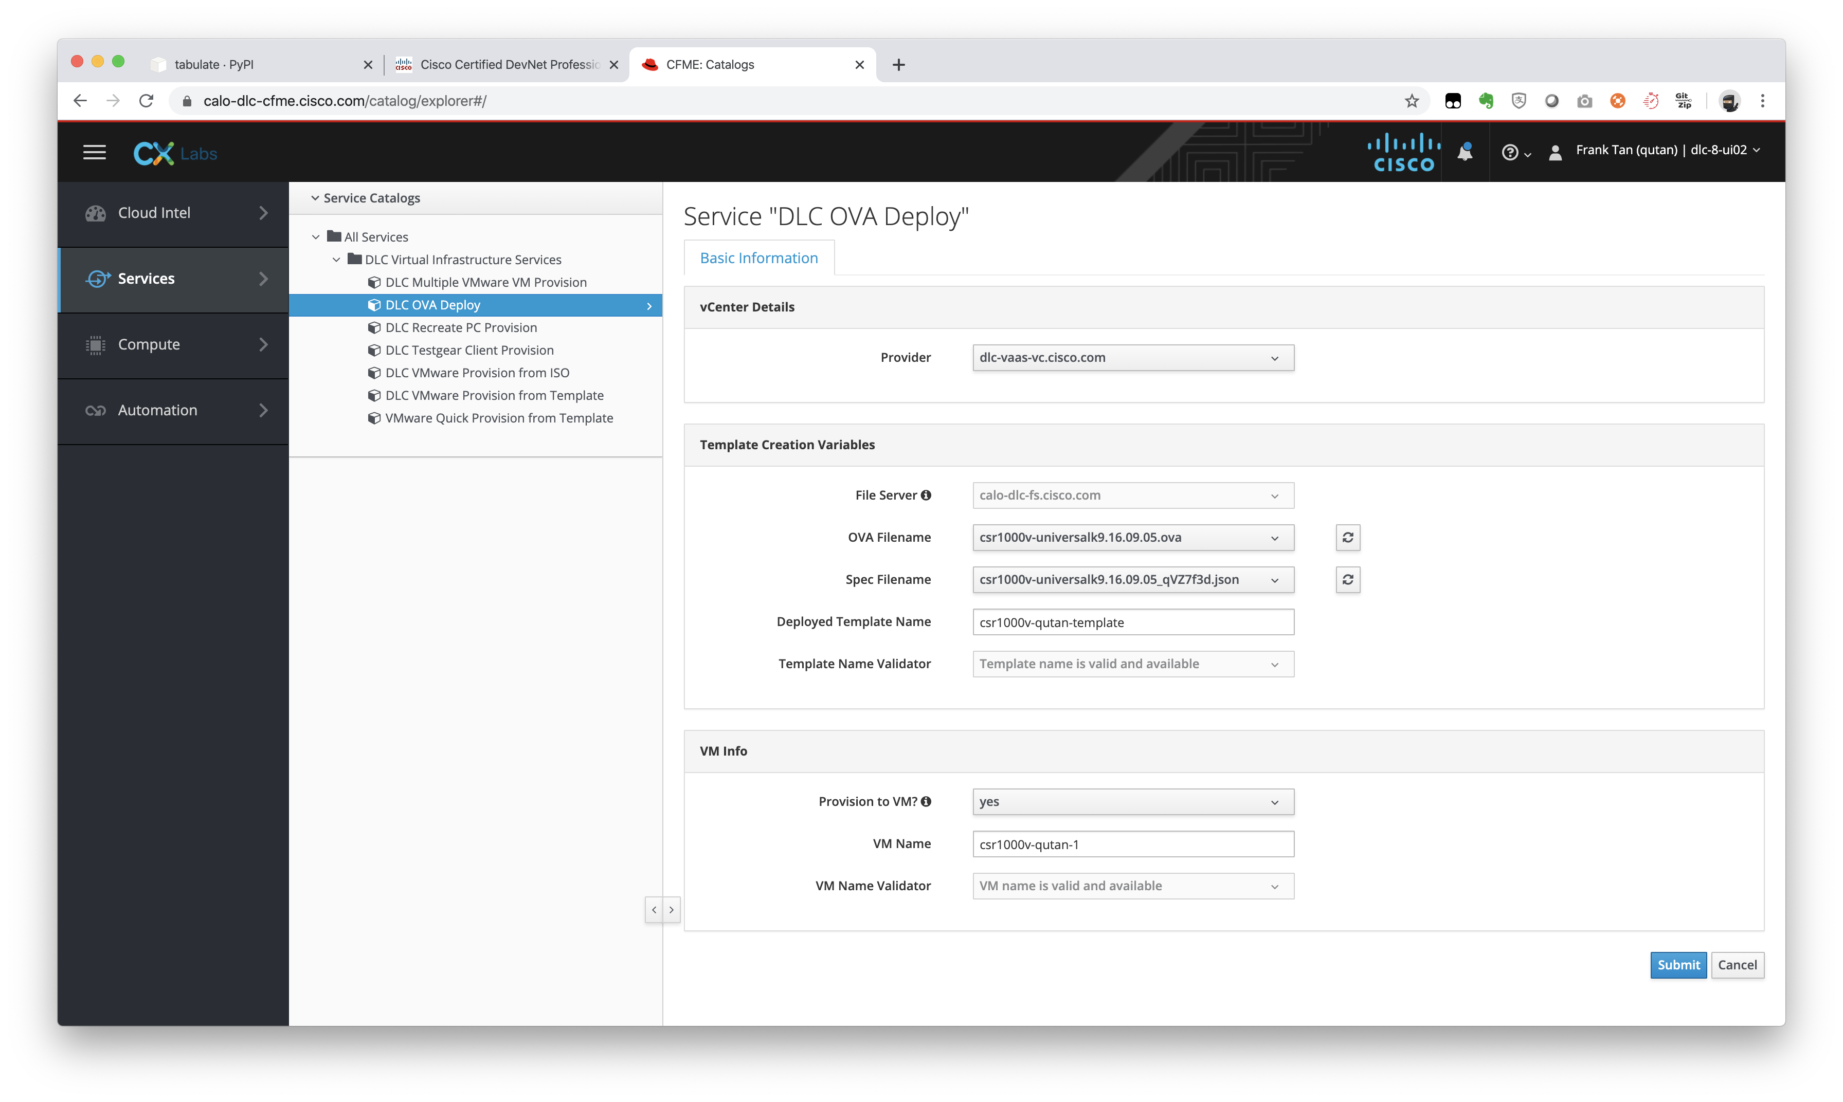

Slide 6
Data Formats - Understanding and Using JSON, XML and YAML

Slide 7


Know Your Audience
Interface | IP-Address | OK? | Method | Status | Protocol
GigabitEthernet1 | 10.0.2.15 | YES | DHCP | up | up
GigabitEthernet2 | 172.16.0.2 | YES | manual | up | up
GigabitEthernet3 | 172.17.0.1 | YES | manual | up | up
> ????

Slide 8

Know Your Audience
{
"ietf-interfaces:interfaces": { "interface": [
{
"name": "GigabitEthernet2", "description": "Wide Area Network", "type": "iana-if-type:ethernetCsmacd", "enabled": true,
"ietf-ip:ipv4": {
"address": [
{
"ip": "172.16.0.2",
"netmask": "255.255.255.0"
}
]
}
},
{
"name": "GigabitEthernet3", "description": "Local Area Network", "type": "iana-if-type:ethernetCsmacd", "enabled": true,
"ietf-ip:ipv4": {
"address": [
{
"ip": "172.17.0.1",
"netmask": "255.255.255.0"
}
]
}
}
]
}
}
> :-)
© 2017 Cisco and/or its affiliates. All rights reserved. Cisco Confidential

Slide 9
Common Data Formats in Programming
XML
JSON
<?xml version="1.0" encoding="UTF-8" ?>
<interface xmlns="ietf-interfaces">
<name>GigabitEthernet2</name>
<description>Wide Area Network</description>
<enabled>true</enabled>
<ipv4>
<address>
<ip>172.16.0.2</ip>
<netmask>255.255.255.0</netmask>
</address>
</ipv4>
</interface>
{
"ietf-interfaces:interface": { "name": "GigabitEthernet2",
"description": "Wide Area Network”,
"enabled": true,
"ietf-ip:ipv4": { "address": [
{
"ip": "172.16.0.2",
"netmask": "255.255.255.0"
}
]
}
}
}
YAML
---
ietf-interfaces:interface: name: GigabitEthernet2 description: Wide Area Network enabled: true
ietf-ip:ipv4:
address:
- ip: 172.16.0.2
netmask: 255.255.255.0

Slide 10

Common Elements in a Data Format
Format Syntax
Objects Representation
Key / Value Notation
Values can be objects, lists, strings, numbers, boolean
Arrays or List Notation
{“priorities”: [ “fire”,
“water”, “club”
]
}

Slide 11
"Key" : "Value"
“Key” identifies/labels a set of data
Left side of the colon
Inside of "quotes"
"Value" is the Data
Right side of colon
Can be:
String
Integer
Array/List
Bool
Object
{
"name": "GigabitEthernet2", "description": "Wide Area Network”, "enabled": true
}

Slide 12
XML

Slide 13
XML- eXtensible Markup Language
<?xml version="1.0" encoding="UTF-8" ?>
<interface xmlns="ietf-interfaces">
<name>GigabitEthernet2</name>
<description>
Wide Area Network
</description>
<enabled>true</enabled>
<ipv4>
<address>
<ip>172.16.0.2</ip>
<netmask>255.255.255.0</netmask>
</address>
</ipv4>
</interface>
A human readable data structure that applications use to store, transfer, and read data.

Slide 14
XML
Designed for the Internet
Schema or namespace defines
data model
<tags></tags> surround elements for structure and layout
Key/Value representation
<key>value</key>
Whitespace not significant
<?xml version="1.0" encoding="UTF-8" ?>
<interface xmlns="ietf-interfaces">
<name>GigabitEthernet2</name>
<description>
Wide Area Network
</description>
<enabled>true</enabled>
<ipv4>
<address>
<ip>172.16.0.2</ip>
<netmask>255.255.255.0</netmask>
</address>
</ipv4>
</interface>

Slide 15
XML Object
A related set of data surrounded by <tags></tags>
An object can contain other objects or data entries
<key>value</key> contained within the object tags
<?xml version="1.0" encoding="UTF-8" ?>
<interface xmlns="ietf-interfaces">
<name>GigabitEthernet2</name>
<description>
Wide Area Network
</description>
<enabled>true</enabled>
<ipv4>
<address>
<ip>172.16.0.2</ip>
<netmask>255.255.255.0</netmask>
</address>
</ipv4>
</interface>

Slide 16
XML List
List of data
Can be composed of XML objects
Repeated instances of <tags></tags> for each element
<?xml version="1.0" encoding="UTF-8" ?>
<addresses>
<ip>172.16.0.2</ip>
<netmask>255.255.255.0</netmask>
</addresses>
<addresses>
<ip>172.16.0.3</ip>
<netmask>255.255.255.0</netmask>
</addresses>
<addresses>
<ip>172.16.0.4</ip>
<netmask>255.255.255.0</netmask>
</addresses>

Slide 17
JSON

Slide 18
JSON -JavaScript Object Notation
{
"ietf-interfaces:interface": { "name": "GigabitEthernet2", "description": "Wide Area Network", "enabled": true,
"ietf-ip:ipv4": {
"address": [
{
"ip": "172.16.0.2",
"netmask": "255.255.255.0"
}
]
}
A human readable data structure that applications use to store, transfer, and read data.
}
}

Slide 19
JSON
A data-interchange text format
Notated with {} for objects, [] for arrays
Key/Value representation
"key": value
Whitespace not significant
{
"ietf-interfaces:interface": { "name": "GigabitEthernet2", "description": "Wide Area Network", "enabled": true,
"ietf-ip:ipv4": {
"address": [
{
"ip": "172.16.0.2",
"netmask": "255.255.255.0"
}
]
}
}
}

Slide 20
JSON Object
Data surrounded by { }
An object can contain other objects or data entries
Key/Value set separated by comma
No comma at the end!
{
"ietf-interfaces:interface": { "name": "GigabitEthernet2", "description": "Wide Area Network", "enabled": true,
"ietf-ip:ipv4": {
"address": [
{
"ip": "172.16.0.2",
"netmask": "255.255.255.0"
}
]
}
}
}

Slide 21
JSON List
List of data
Can be composed of JSON objects
Notated with brackets
Comma Separated
{
"addresses": [
{
"ip": "172.16.0.2",
"netmask": "255.255.255.0"
},
{
"ip": "172.16.0.3",
"netmask": "255.255.255.0"
},
{
"ip": "172.16.0.4",
"netmask": "255.255.255.0"
}
]
}

Slide 22
YAML

Slide 23
YAML –YAML Ain’t Markup Language
---
ietf-interfaces:interface: name: GigabitEthernet2 description: Wide Area Network enabled: true
ietf-ip:ipv4: address:
- ip: 172.16.0.2
netmask: 255.255.255.0
A human readable data structure that applications use to store, transfer, and read data.

Slide 24
YAML
Minimalist format commonly used for configuration files
Whitespace indentation defines structure
No commas
Key/Value representation
key: value
---
ietf-interfaces:interface: name: GigabitEthernet2 description: Wide Area Network enabled: true
ietf-ip:ipv4: address:
- ip: 172.16.0.2
netmask: 255.255.255.0

Slide 25
YAML Object
Related set of data at the common indentation level under name
An object can contain other objects or data entries
key: value pairs left aligned
---
ietf-interfaces:interface: name: GigabitEthernet2 description: Wide Area Network enabled: true
ietf-ip:ipv4: address:
- ip: 172.16.0.2
netmask: 255.255.255.0

Slide 26
YAML List
List of data
Can be composed of YAML objects
Uses “-” character to indicate a list element
---
addresses:
- ip: 172.16.0.2
netmask: 255.255.255.0
- ip: 172.16.0.3
netmask: 255.255.255.0
- ip: 172.16.0.4
netmask: 255.255.255.0

Slide 27
Python for Network Engineer

Slide 28
Why Python?
Readable and easy to learn
Widely available and Open Source
Windows, Mac, Linux
Routers & Switches
Many relevant code samples
Lots of training resources
Notes:
Why Python?
We could have chosen one of several languages for this track, but we chose Python. Here's why:
Domain Applicability - For network and IT infrastructure engineers, there is a well established online community of infrastructure engineers using Python to deploy and maintain IT systems. This means you can leverage (and contribute to) the work done by this collective community to save yourself (and others) time as we all strive to complete common tasks together.
Yes, there are infrastructure engineers using other languages, and those languages are in no way inferior to Python. Python appears to have the broadest community (to date) for our domain.
Power and Flexibility - As already discussed, Python is a modern language that brings coding into the level-of-effort range of being useful to infrastructure engineers. Python is a "batteries included" language with a rich and diverse developer ecosystem. This means that it will serve you well as you progress in your journey. If your work leads to you needing to: create a backend web service, interact with a data base, do some data analysis, work with machine learning algorithms, or create a simple (or powerful) command line tool, Python and its developer community have you covered. You shouldn't have to "start from scratch," and you should be able to get powerful tasks done with reasonable investments of effort.
Platform Flexibility - Your Python scripts can run: on a computer (Windows, macOS, or Linux), on a server, in a VM, in a container, in the cloud, and on some Cisco IOS devices. This means you can use Python to create scripts that can run in a variety of places to fit the needs of your use case.
Personal Bias - The proctors and presenters of this event are a little biased towards Python. We have stickers on our laptops, t-shirts, social profiles, and emotional connections to our code that make us a little partial. 😁
If you are still with us, you are ready to start learning to code!

Slide 29

Python Scripts
Text Files (UTF-8)
May contain Unicode Some editors / terminals don’t support Unicode
Use any Text Editor Using a Python-aware editor will make your life better
No Need to Compile Them
Notes:
Python scripts are simple (UTF-8) text files. You could write or edit one with any text editor. You don't compile them. How are you going to execute them? Answer: with a Python interpreter!

Slide 30
Basic Python Syntax
Notes:
Now that you know how to use your interpreter, let's dive-in and start learning Python.
In all of the sections that we go through, please take a minute to experiment with the Python syntax in your interactive shell. You aren't going to break anything (probably), and getting your hands on the syntax is the best way to learn it and get comfortable with it.
Don't feel like you have to type in any of our examples verbatim - try your own. See what works and what doesn't - you'll learn from both.

Slide 31
Basic Data Types
Python type() | Values (examples)
int | -128, 0, 42
float | -1.12, 0, 3.14159
bool | True, False
str | “Hello 😎” Can use ‘’, “”, and “”””””
bytes | b”Hello \xf0\x9f\x98\x8e”
>>> type(3) <class ‘int’>
>>> type(1.4)
<class ‘float’>
>>> type(True) <class ’bool’>
>>> type("Hello") <class ’str’>
>>> type(b"Hello")
<class ‘bytes’>
Notes:
Note: These are best introduced by briefly using the Python interactive shell and demoing using the built-in type() function.
As you would expect, Python has a basic data type to store any value you need.
Python is introspective. You can see what type of data something is with the type()function. Can't remember what Python's string data type is called? Just ask it, type("What is this?") - it will tell you.

Slide 32
Numerical Operators
Math Operations
Addition: +
Subtraction: -
Multiplication: *
Division: /
Floor Division: //
Modulo: %
Power: **
>>> 5 + 2
7
>>> 9 * 12
108
>>> 13 / 4
3.25
>>> 13 // 4
3
>>> 13 % 4
1
>>> 2 ** 10
1024
Notes:
It also has a full set of operators to work with these numeric and string types.
Try playing with some of these in your Interactive Interpreter.
You could use the Python interactive shell as a powerful calculator. Python is used by mathematicians and scientists, and is capable of doing high-precision and complex mathematical operations (or you could use it to calculate the tip for your pizza order).
Want some geek fun? Try this one in your interactive shell:
>>> 1024 ** 15700
It might take your workstation a few seconds to calculate that one, but it will get it right. Feel free to check it by hand if you don't trust it yet.

Slide 33
Variables
Names
Cannot start with a number [0-9]
Cannot conflict with a language keyword
Can contain: [A-Za-z0-9_-]
Recommendations for naming (variables, classes, functions, etc.) can be found in PEP8
Created with the = assignment operator
Can see list of variables in the current scope with dir()
>>> b = 7
>>> c = 3
>>> a = b + c
>>> a
10
>>> string_one = "Foo"
>>> string_two = "Bar"
>>> new_string = string_one + string_two
>>> new_string
'FooBar'
Notes:
Defining Variables
Python is not a strongly typed language. That means, unlike some other languages, you don't have to declare a variable before using it. Also, a variable name could point to one type of data one minute and then point to a different type of data another.
To define a variable in Python, simply use the assign = operator to assign a value to the variable name.
Note: In the interactive interpreter, typing a variable name at the prompt and pressing Enter displays the current value of the variable. Also note that while this is a valid Python statement, if you only put a variable name on a line in your script, it won't display the output to the user. You have to use the print() function in a script to display output to the user (you learn how to do this shortly).
Variable Names
Cannot start with a number [0-9]
Cannot conflict with a language keyword
Can contain: [A-Za-z0-9_-]
Recommendations for naming (variables, classes, functions, etc.) can be found in PEP8.

Slide 34
In Python, Everything is an Object!
Use . (dot) syntax to access “things” inside an object.
Terminology
When contained inside an object, we call…
Variable → Attribute
Function → Method
>>> a = 57
>>> a.bit_length()
6
>>> "WhO wRoTe THIs?".lower()
'who wrote this?'
Check an object’s type with type(object)
Look inside an object with dir(object)
Notes:
Everything is an Object!
In Python everything is an object. What does this mean? Unlike some languages that have different types of data (value types, structures, classes and objects, etc.), in Python everything is an object.
What are objects, and what does this mean for me? I'm glad you asked.
Objects (over simplified explanation) are purpose-built groupings of variables (called attributes) and functions (called methods) that work together to do something useful.
Creating your own classes of objects in Python is easy, but due to time constraints and the fact that you won't need to create your own classes to complete any of our labs today, we aren't going to cover classes here. However, you do need to know how to work with objects - especially since "everything is an object". Fortunately doing so is also straightforward, and you have already seen this in action in the when we looked at how to work with strings.
To access the attributes (variables) or methods (functions) contained within an object, all you need to remember is that you use "." dot-syntax to do so. Putting a period (dot) after any object lets you access the attributes and methods available within the object.
Examples – See the right panel
Note: Python is introspective. To look inside an object and see what names (attributes and methods) are defined inside it, just pass the object to the dir(object) function.

Slide 35
Working with Strings
String Operations
Concatenation: +
Multiplication: *
Some Useful String Methods
Composition: “{}”.format()
Splitting: “”.split()
Joining: “”.join()
>>> "One" + "Two"
'OneTwo'
>>> "Abc" * 3
'AbcAbcAbc'
>>> "Hi, my name is {}!".format("Chris")
'Hi, my name is Chris!'
>>> "a b c".split(" ")
['a’, 'b’, 'c']
>>> ",".join(['a’, 'b’, 'c'])
'a,b,c'
Notes:
Strings
In Python v3 all strings (str) are Unicode strings and therefore can store and work with multi-byte Unicode characters. Note that not all Terminals or platforms support these extended character sets, so use them at your own risk, but Python supports them - hopefully everything else will catch up.
You can use any of the following to open and close a string:
Single Quotes ' '
Double Quotes " "
Triple Single Quotes ''' '''
Triple Double Quotes """ """
Why all the options? The ability to use single or double quotes as string delineators makes it easier for you to create strings that may contain quotation marks. For example, if you want to include double quotes inside your string, open and close the string with single quotes and vice versa.
Without the option to use the other quotation mark style to open and close the string, you would have to \ escape all the quotation marks inside the string.
What about the triple quotes?
These let your string break across lines, and cause the string to include \n newline characters everywhere where there are line breaks in the multiline string - essentially you can write multiline strings just by using the triple opening and closing quotes.
Note: A triple quoted string at the beginning of a Python file, function or class has special meaning. These are called docstrings, and they are a great way to document what the Python file, function or class does and how it should be used.
String Operators
Working with strings in Python is easy.
Want to put two strings together (concatenate)? Just add them.
Note: This doesn't insert any space between the strings. It simply joins the two strings together into a new string.
Weird enough, you can multiply strings. This is actually useful when, for example, you want to repeat a character a certain number of times.
There are also some powerful "convenience" methods available with string objects (more on objects later):
"{}".format() - The .format() method lets you insert named or unnamed placeholders {}in a string and then use the .format() method to insert values into those placeholders.
"".split() - The .split() method lets you split a string into multiple strings using a separator that you provide as the delimiter.
"".join() - The .join() method lets you put a sequence of strings together using, joining them with a separator that you provide.
Examples – See the right panel

Slide 36
Basic I/O
Get Input with input()
Pass it a prompt string
It will return the user’s input as a string
You can convert the returned string to the data type you need int(), float(), etc.
Display Output with print()
Can pass multiple values
It will concatenate those values with separators in between (default = spaces)
It will add (by default) a newline (‘\n’) to the end
>>> print(‘a’, ‘b’, ‘c’)
a b c
>>> i = input(“Enter a Number: ”)
Enter a Number: 1
>>> int(i)
1

Slide 37
Conditionals
Syntax:
if expression1:
statements…
elif expression2:
statements…
else:
statements…
Indentation is important!
4 spaces indent recommended
You can nest if statements
Comparison Operators:
Less than <
Greater than >
Less than or equal to <=
Greater than or equal to >=
Equal ==
Not Equal !=
Contains element in
Combine expressions with: and, or
Negate with: not
Notes:
Conditionals
With variables comes the possibility (likelihood) that you may not know what they point to, or perhaps you want to branch your code and take different paths based on some condition. That's why we have if statements.
Python if Syntax
Indentation is important! In Python, indentation is syntactically significant. Python uses indentation to identify the block of statements that are associated with a preceding statement. By PEP8 convention, indentation should be four (4) spaces. Most "Python aware" text editors and IDEs will automatically insert four spaces when you press the Tab key.
The above if syntax reads:
If expression1 is True, do the following block of indented statements
Else if expression2 is True, do the following block of indented statements
Else do the following block of indented statements
Note: In this syntax, the expressions can be any Python expression that evaluates to a True or False value (see Python Truth Value Testing for more details).
A conditional need not have all of these elements. You could have a single if statement, with some set of statements to run if it evaluates to True. You could have many else-if elifstatements. You may only have one default or catch-all else statement.
Note: Python evaluates the if and elif statements starting with the first and proceeding to the last. If any of expressions evaluate to True, it runs the block of statements associated with that if/elif clause and then skips the rest of the clauses and continues with the next statement after the if-block.
You can combine expressions with and or or. Negate an expression with not.

Slide 38
Conditionals | Examples
>>> b = 5
>>> if b < 0:
... print("b is less than zero")
... elif b == 0:
... print("b is exactly zero")
... elif b > 0:
... print("b is greater than zero")
... else:
... print("b is something else")
...
b is greater than zero
>>> words = "Foo Bar"
>>> if "Bar" in words:
... print("words contains 'Bar'")
... elif "Foo” in words:
... print("words contains 'Foo'")
...
words contains 'Bar'

Slide 39
Functions | Don’t Repeat Yourself
Modularize your code
Defining your own Functions
(optionally) Receive arguments
(optionally) Return a value
Syntax:
def function_name(arg_names):
statements…
return value
...
function_name(arg_values)
>>> def add(num1, num2):
... result = num1 + num2
... return result
...
>>>
>>> add(3, 5)
8
>>> def say_hello():
... print("Hello!")
>>>
>>> say_hello()
Hello!
Notes:
"Don't Repeat Yourself (DRY)”
Find yourself writing blocks of identical or nearly identical code in several places throughout your script (or in several of your scripts)? It's time to create a function. Functions let you write a piece of code once, give it a name, and then call that piece of code whenever you need it. They can (optionally) accept input arguments and return an output allowing you to create operations that take some input(s) and return some output according to your needs.
Python Function Syntax:
def function_name(arg_1, arg_2):statements...return valueAgain indentation is important!
You use the def keyword to define a function, and you must follow the same rules when naming functions as you do when naming variables:
Cannot start with a number [0-9]
Cannot conflict with a language keyword
Can contain: [A-Za-z0-9_-]
Recommendations for naming (variables, classes, functions, etc.) can be found in PEP8.
When defining a function, arguments are variable names that you create. Lateron when you call your function, you will pass in values for each of the arguments and these values will be assigned to the variable names you defined. These variables can be used within the body of your function to do as you need to carry out the purpose of your function.
Your function may optionally return some value.
Example:
def add(num1, num2):...result = num1 + num2...return result...>>>>>>add(3, 5)8Note: Defining a function (def) only "creates" it for later use. Your function's code doesn't actually run until you call it (see the add() example above). No addition was performed until we called the add function and supplied values for its arguments with the add(3, 5)statement. You typically define a function once and then call it many times; passing in arguments and getting outputs each time.
A function doesn't have to have any arguments or return any values. You could simply be calling a function to do some predefined set of actions.
>>>def say_hello():...print("Hello!")>>>>>>say_hello()Hello!Note: A function implicitly returns None if it reaches the end of the function's block of statements. None is a special Python singleton value. It essentially means "no value." Noneis the closest thing Python has to a null value that is present in some other languages.
Next: Hands-On Exercise

Slide 40
Python Collections & Loops

Slide 41
Data Structures / Collection Data Types
Name type() | Notes | Example
list | Ordered list of items Items can be different data types Can contain duplicate items Mutable (can be changed after created) | [‘a’, 1, 18.2]
tuple | Just like a list; except: Immutable (cannot be changed) | (‘a’, 1, 18.2)
dictionary dict | Unordered key-value pairs Keys are unique; must be immutable Keys don’t have to be the same data type Values may be any data type | {“apples”: 5, “pears”: 2, “oranges”: 9}
Notes:
Python comes fully equipped with a full set of native data structures. We are going to take a look at the three most commonly used data structures: lists, tuples, and dictionaries.
As you work through this step, open your Python interactive interpreter and try creating each of the data types. Try accessing and updating individual elements of the collections. As you move on to working with more complex programs and APIs (and the data they return), it is essential that you be comfortable with these basic concepts.
Lists
A list is an ordered list of items. Items can be different data types. You may have duplicates of an item in a list. Lists are immutable, meaning they can be changed after they have been created. You can update the elements of a list. You can append new items to a list. You can remove items from a list. You can change the order of items in a list. In short you can change them as needed.
Tuples
Tuples are essentially just list lists, with one major exception: they are immutable, meaning they cannot be changed after they have been created. They are “frozen” as they were initially created.
Dictionaries
Dictionaries store unordered key-value pairs. They are mutable, so you can add and remove items as needed. You may at any time store a value for a key, and then later retrieve that value by providing the key.
Dictionary keys must be an immutable data type, but values can be any data type. As an FYI, all of the python basic data types that we have looked at (int, float, bool, str, and etc.) are immutable and may be used as dictionary keys.
While it may at times (python v3.6+) seem like Python is maintaining the order that items were added to a dictionary… It isn’t. Regular `dict` dictionaries are not guaranteed to maintain the order of items added to a dictionary. If you need to maintain the order, use an OrderedDict (more on these in a bit).

Slide 42
Working with Collections
Name type() | Creating | Accessing Indexing | Updating
list | l = [‘a’, 1, 18.2] | >>> l[2] 18.2 | >>> l[2] = 20.4 >>> l [‘a’, 1, 20.4]
tuple | t = (‘a’, 1, 18.2) | >>> t[0] ‘a’ | You cannot update tuples after they have been created.
dict | d = {“apples”: 5, “pears”: 2, “oranges”: 9} | >>> d[“pears”] 2 | >>> d[“pears”] = 6 >>> d {“apples”: 5, “pears”: 6, “oranges”: 9}
Notes:
Creating
Lists – You create lists by enclosing the list of items within square braces `[ ]` and separating the items with commas `,`.
Tuples – You create tuples by enclosing the items within parentheses `( )` and separating the items with commas `,`.
Dictionaries – You create dictionaries by enclosing the items within curly braces `{ }`, separating the keys and values with colons `:`, and separating the key-value pairs with commas `,`.
Accessing Elements in Collections (Indexing)
You access the elements within a collection using the square braces `[ ]`. We call this indexing.
Lists and Tuples, are ordered sequences, and like all good programming languages indexes start with zero `0`. So, the first element in a list is at index `0`, the next element is at index `1`, and so forth. To access an element in a list you simply provide the numerical index for the element you want in square braces.
Dictionaries are indexed by their keys. To access an element within a dictionary, simply provide the key in square braces `[ ]` for the value you want to retrieve from the dictionary.
Updating Elements in a Collection
To update elements in a collection (change their values), assign the new value to the collection’s index that you want to change.
Note, again, tuples are immutable and cannot be updated after they have been created.

Slide 43
Dictionary Methods
Some useful dictionary methods:
{}.items()
{}.keys()
{}.values()
There are many more! 😎
>>> d = {"a": 1, "b": 2, "c": 3}
>>> d.items()
dict_items([('a’,1), ('b’,2), ('c',3)])
>>> d.keys()
dict_keys(['a’, 'b’, 'c’])
>>> d.values()
dict_values([1, 2, 3])
Notes:
When working with dictionaries, there are at least a few things that you are very likely to want to do: get a list of all of the items (key-value pairs) in a dictionary, or get a list of all the keys, or get a list of all the values…
Fortunately, Python has you covered. Just use the items(), keys(), and values() methods to get what you need. Oh… and there are more where those came from. ☺ Since Python is a “batteries included” language, much of the functionality you are looking for is built-in to the language and its standard library.

Slide 44
Other “Batteries Included” Collections
Collection | Description
namedtuple() | factory function for creating tuple subclasses with named fields
deque | list-like container with fast appends and pops on either end
ChainMap | dict-like class for creating a single view of multiple mappings
Counter | dict subclass for counting hashable objects
OrderedDict | dict subclass that remembers the order entries were added
defaultdict | dict subclass that calls a factory function to supply missing values
UserDict | wrapper around dictionary objects for easier dict subclassing
UserList | wrapper around list objects for easier list subclassing
UserString | wrapper around string objects for easier string subclassing
Learn More @
docs.python.org
Notes:
What if you need something more? Python may you have covered…
There are a number of additional collections included in the Python language and Standard Library.
To keep this content as concise and focused as possible, we didn’t cover all of the language’s built-in data structures. We hit the most common three (lists, tuples, and dictionaries), but there are other powerful data structures (like sets) built-in to the language and the standard library. For example, these are some additional collections that are available in the `collections` module in the Python Standard Library. These are installed and available on every Python installation (of a recent enough version).
The good news here is that these are all at your fingertips when and where you need them. Remember: Google is your friend! When you find yourself needing a tool to solve a particular problem, google it. Chances are, between the Python docs and StackOverflow, you’ll see something that either does exactly what you need or gets you well on your way to solving the problem.
…and when it comes to working with Collections, you already have the basic skills you need to work with data no matter what data type you are working with.

Slide 45
OrderedDict Collection
>>> from collections import OrderedDict
>>> od = OrderedDict()
>>> od["apples"] = 5
>>> od["pears"] = 2
>>> od["oranges"] = 9
>>>
>>> od["pears"]
2
>>> od["bananas"] = 12
>>> od
OrderedDict([('apples',5), ('pears',2), ('oranges',9), ('bananas',12)])
Notes:
Example: OrderedDict Collection
Ordered Dictionaries work almost exactly like the native dict data structures, with one enhancement: they maintain the order of the items added to them.
Since this collection isn't a native data structure, but one that is included in the Standard Library (meaning it should be installed and available on every computer that has a recent enough version of Python installed), we do have to import it into our script to enable us to use it - we'll learn more about imports shortly.
Check out this example of using an OrderedDict. This is doing the exact same thing we did with the dict example in the previous step.
This OrderedDict worked just like the dict data structure with the following differences:
We did have to import it before we could use it.
We added the key-value pairs to it incrementally, to demonstrate how it maintains the order in which they were added.
When you look at the contents of the OrderedDict it looks a little different OrderedDict(<list of tuples>).
Other than these differences, they work exactly the same.

Slide 46
Loops
Iterative Loops
for individual_item in iterator:
statements…
Conditional Loops
while logical_expression:
statements…
>>> names = ["chris", "iftach", "jay"]
>>> for name in names:
... print(name)
...
chris
iftach
jay
>>> i = 0
>>> while i < 5:
... print(i)
... i += 1
...
0
1
2
3
4
Notes:
Iterative Loops
A for loop iterates through a sequence or collection, essentially taking one item at a time (assigning it to the variable name that you provide) and running the block of statements until all of the items have been iterated through (or you manually break out of the loop from within the code block).
Python for Loop Syntax
In this syntax individual_item is just a variable name of your choosing, and an iterator is something that can be iterated. Many things can be iterated, but for our purposes you should know that lists, tuples, and dictionaries can all be iterated.
Choosing Variable Names
You can make your code readable by choosing your variable names wisely:
By naming my list of names "names" (plural) and then choosing "name" (singular) as my loop variable, this code reads as follows: "Create a list of names. For each name in the names-list, print the name," and that is just what it does.
Conditional Loops
Conditional loops (while loops in Python) evaluate an expression before each iteration of the loop. If the expression evaluates to True, the loop statements are executed. If the expression evaluates to False, the loop statements are not executed and the script continues with the first line after the loop block.
Python while Loop Syntax
In this syntax, expression can be any Python expression that evaluates to a True or False value (see Python Truth Value Testing for more details).
Note: You can use Ctrl-C to break of infinite loops or hung scripts.

Slide 47
Unpacking
Q: What if you wanted to break out a collection to separate variables?
A: Unpack them!
>>> a, b, c = [1, 2, 3]
>>> a
1
>>> b
2
>>> c
3
Notes:
Python has a feature where you can assign a collection of items to a set of variables - this is called unpacking.
We’ll use this a little later in combination with a a for loop to help us iterate through a dictionary.
What’s a for loop? I’m glad you asked…

Slide 48
Iterating through a Dictionary
Use the dictionary .items() method, which returns a “list of tuples”
Unpack each tuple into variable names of your choosing to use within your block of statements
Method returns dictionary items as a list of (key, value) tuples, which the for loop will iteratively unpack into your variable names.
>>> for fruit, quantity in fruit.items():
... print("You have {} {}.".format(quantity, fruit))
...
You have 5 apples.
You have 2 pears.
You have 9 oranges.
Notes:
Here is the trick to iterate through a dictionary of key-value pairs:
Iterate the dictionary items() method, which returns a list of (key, value) tuples.
Use unpacking to unpack the tuple’s (key, value) pair into variable names of your choosing.
This code reads as follows:
“For each fruit (key), quantity (value) pair in the fruit.items() list, print this string inserting the current values of fruit and quantity into the placeholders.”

Slide 49
What are Libraries and How to Use Them

Slide 50
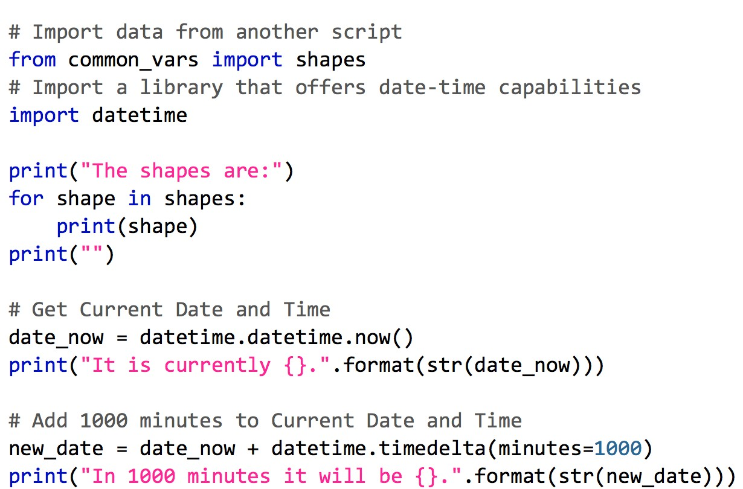
Python Libraries (Modules, Applications, etc)
Any Python code outside of your script you want to use
Provide some capability or data you need
Included with statements
from library import name
import library

Slide 51
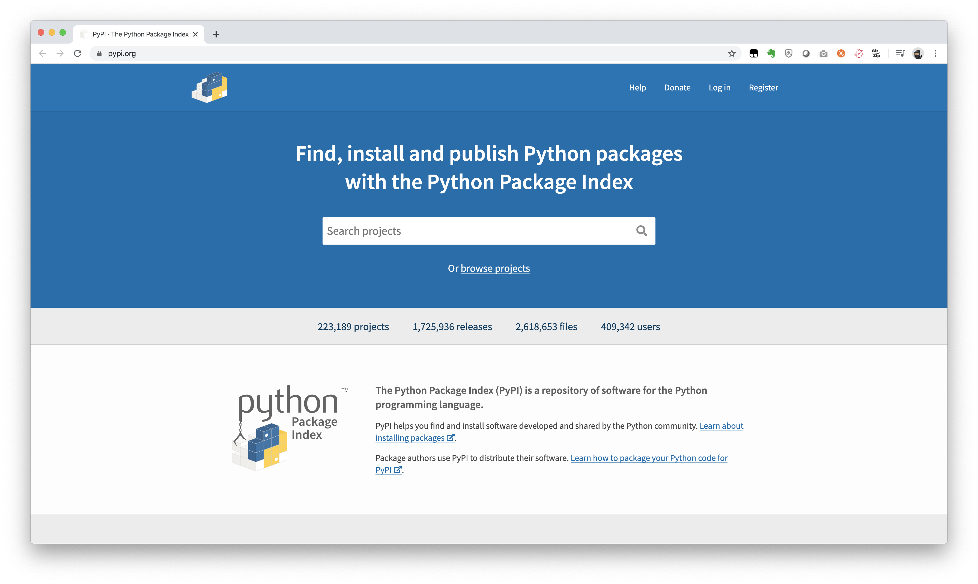
Where to get Libraries
Write them yourself
Example: common_vars
Included with Python itself
Example: datetime, os, sys, json
From Python Package Index (PyPI)
Example: pip install requests
Download and install manually
Example: ACI Toolkit from GitHub

Slide 52
Using pip to Install Libraries

Slide 53
Pip - The Python Package Installer
Python 2.7.6 and Python 3.4 or greater includes by default
Integrates with PyPI for packages
Install, Upgrade, and Uninstall packages
“requirements.txt” in projects provide input to pip
DevNet$ pip --version pip 9.0.1
DevNet$ pip install pyang
Collecting pyang
Downloading pyang-1.7.3-py2.py3-none-any.whl (326kB)
100% |████████████████████████████████| 327kB
1.3MB/s
Installing collected packages: pyang Successfully installed pyang-1.7.3
DevNet$ pip install -r requirements.txt
Collecting requests (from -r requirements.txt (line 1))
Downloading requests-2.18.2-py2.py3-none-any.whl (88kB)
100% |████████████████████████████████| 92kB
662kB/s
.
{OUTPUT TRUNCATED}
.
Successfully installed requests-2.18.2 six-1.10.0
urllib3-1.22

Slide 54
pip Commands to Know
Install a package
pip install package
Upgrade a package
pip install --upgrade package
Uninstall a package
pip uninstall package
View all packages installed
pip freeze
Install “requirements.txt”
pip install –r requirements.txt
DevNet$ pip freeze
asn1crypto==0.22.0 bcrypt==3.1.3 certifi==2017.4.17 cffi==1.10.0 chardet==3.0.4 cryptography==2.0 flake8==3.3.0 idna==2.5 lxml==3.8.0 mccabe==0.6.1 ncclient==0.5.3 paramiko==2.2.1 pyang==1.7.3 pyasn1==0.2.3 pycodestyle==2.3.1 pycparser==2.18 pyflakes==1.5.0 PyNaCl==1.1.2
requests==2.18.2
six==1.10.0
urllib3==1.22

Slide 55
Virtual Environments

Slide 56
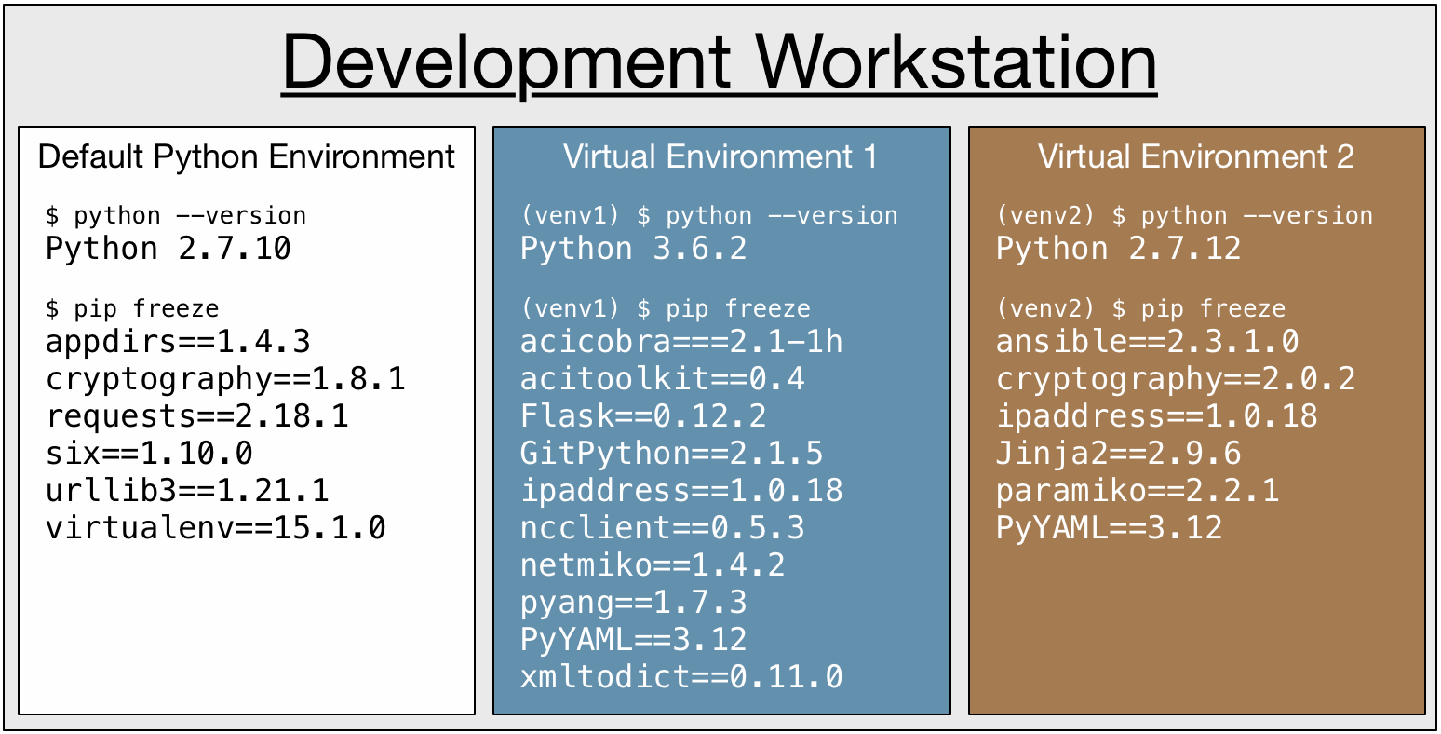
What is a Virtual Environment (venv)
Build isolated, fully functional Python environments on a single workstation
Virtual Environments can
Run different versions of Python
Have different libraries installed
Have different versions of libraries installed

Slide 57
Setting Up a Virtual Environment
Install the virtualenv library
pip install virtualenv
Create the Virtual Environment
virtualenv name
Specify Python Version
virtualenv name --python=python3
Activate Virtual Environment
source name/bin/activate
Deactivate Virtual Environment
deactivate
DevNet$ pip install virtualenv Successfully installed virtualenv
DevNet$ virtualenv venv
New python executable in
/private/tmp/venv/bin/python2.7 Also creating executable in
/private/tmp/venv/bin/python
Installing setuptools, pip, wheel...done.
DevNet$ virtualenv venv2 --python=python3 Running virtualenv with interpreter
/usr/local/bin/python3
Using base prefix '/usr/local/Cellar/python3/3.6.2/Frameworks/Python.fram ework/Versions/3.6'
New python executable in
/private/tmp/venv2/bin/python3.6
Also creating executable in
/private/tmp/venv2/bin/python
Installing setuptools, pip, wheel...done.
DevNet$ source venv/bin/activate
(venv) DevNet$

Slide 58
Installing Python Libraries in Virtual Environments
Once activated, no different
(venv) DevNet$ pip install pyang Collecting pyang
Downloading pyang-1.7.3-py2.py3-none-any.whl (326kB)
100% |████████████████████████████████| 327kB
1.3MB/s
Installing collected packages: pyang Successfully installed pyang-1.7.3
(venv) DevNet$ pip install -r requirements.txt Collecting requests (from -r requirements.txt (line 1))
Downloading requests-2.18.2-py2.py3-none-any.whl
(88kB)
100% |████████████████████████████████| 92kB
662kB/s
.
{OUTPUT TRUNCATED}
.
Successfully installed requests-2.18.2 six-1.10.0 urllib3-1.22

Slide 59
Useful Libraries for Network Engineers

Slide 60
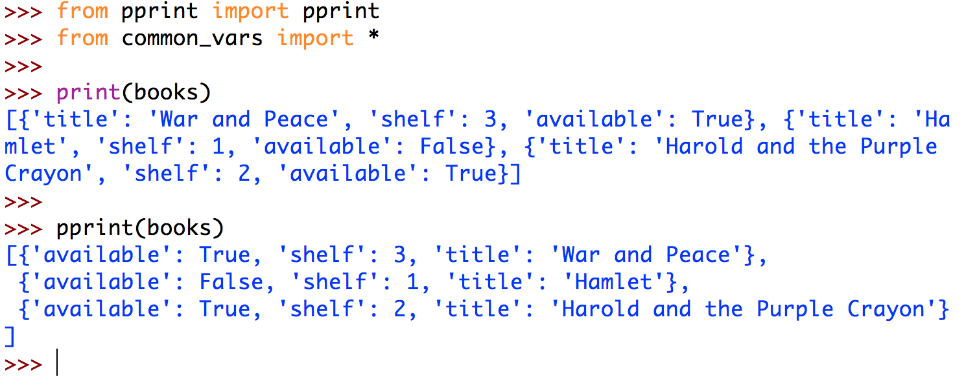
Prettier Printing with pprint
Better formatting than default print() function

Slide 61
Access Details about Python with sys
Access to some details/variables concerning running state
Access command line arguments with sys.argv[]
Access to functions that interact with the interpreter
Exit Python with specific error message sys.exit("Message")
DevNet$ python -i common_vars.py "CLI Arg 1" "CLI Arg 2"
>>>
>>> import sys
>>>
>>> sys.argv[1] 'CLI Arg 1'
>>> sys.argv[2]
'CLI Arg 2'
>>>
>>> sys.exit("Error Occurred") Error Occurred

Slide 62
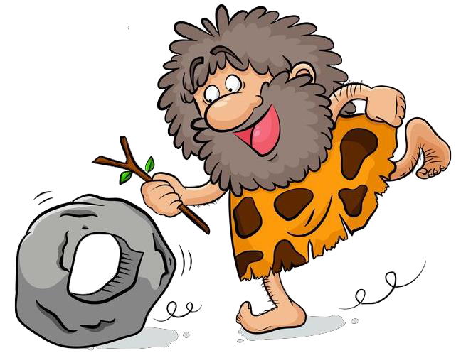
Demo Time!
venv
2.net_programming/demo/pprint_json.py
© 2017 Cisco and/or its affiliates. All rights reserved. Cisco Confidential

Slide 63
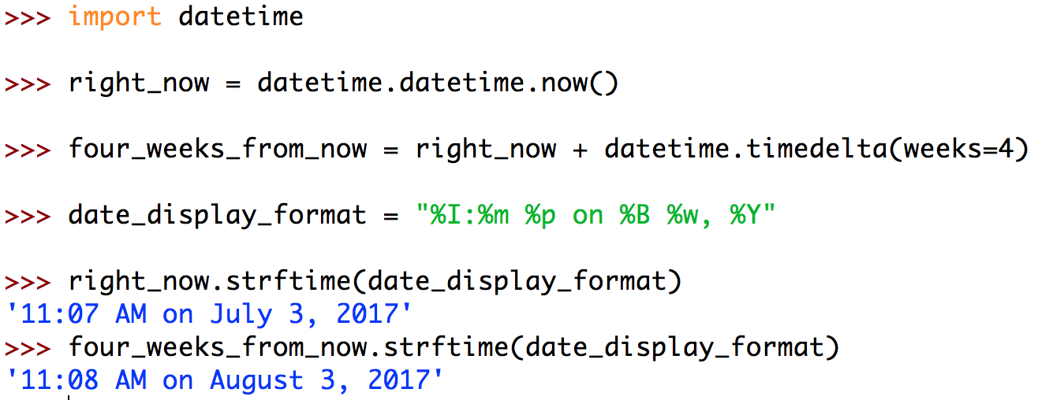
Get your Date and Time Correct with datetime
Create, format, and manipulate dates and times
Time arithmetic!
Work with timestamps and other representations

Slide 64
Libraries to Work with Data
XML - xmltodict
pip install xmltodict
import xmltodict
JSON
import json
YAML - PyYAML
pip install PyYAML
import yaml
CSV
import csv

Slide 65
Parsing JSON with Python

Slide 66
What is JSON?
Standardized format for passing data as text.
JavaScript Object Notation
Looks strikingly similar to Python’s syntax for dictionaries, lists, strings and number types!
…BUT… JSON is just text!
Notes:
Q: Why store and share data in text format? A: What other format are you going to use?
Working with data within your own code is great (using your language's native syntax and data types), but what about when you need to share data between applications? How are you going to format the data so that the other app will understand it? You could export data in some binary format, but doing so tends to be very proprietary and difficult to work with. Using a structured text format provides a few immediate benefits:
Structured Text is:
Human Readable (some formats more so than others)
Easily Transportable (many methods exist to send/receive text)
Machine Parsable (an app can parse the text to extract the structured data)
When needing to send data between applications, we could invent our own formats for how we want to structure the data we are sharing as text, but this doesn't scale - everyone wanting to get data from you would have to learn "your format." Standardized Data-Interchange Formatsallow us to learn one, okay a few, data formats that we can all use to send data back and forth between applications.
Benefits of Standardized Data-Interchange Formats:
We don't have to invent them when we want to share data.
We don't have to write the code to parse these formats, others have already done this for us.
Once you understand their syntax, you (as a human) can read and write them yourself (it's just text).
There are several prominent standardized data-interchange formats in use today, with the following being the most pervasive:
JSON (JavaScript Object Notation)
XML (eXtensible Markup Language)
YAML (YAML Ain't Markup Language)
JSON stands for JavaScript Object Notation, and it is a standardized data-interchange format used to exchange data as structured text between many applications and programming languages.
You don't have to know any JavaScript to use and understand JSON data.
JSON syntax is relatively lightweight (compared to XML) and easy to learn. In fact, as a Python coder you already know most of the syntax.

Slide 67
JSON Syntax vs. Python Syntax
{
"ietf-interfaces:interface": {
"name": "GigabitEthernet2",
"description": "Wide Area Network",
"enabled": true,
"ietf-ip:ipv4": {
"address": [
{
"ip":"172.16.0.2",
"netmask":"255.255.255.0"
}
]
}
}
}
{
'ietf-interfaces:interface': {
'name’: 'GigabitEthernet2’,
'description’: 'Wide Area Network’,
'enabled’: True,
'ietf-ip:ipv4': {
'address': [
{
'ip':'172.16.0.2’,
'netmask':'255.255.255.0’,
},
],
},
},
}
JSON
Python
Notes:
Take a look a look at the following JSON data, and compare it to the exact same data in parsed into native Python data structures. Look familiar? It should! JSON syntax is almost identical to syntax used by Python's native data structures; however, there are a few important differences.
Can you spot the differences?
You might have noticed:
The use of single vs. double quotes. Python doesn't care, but JSON does. JSON strings must be delineated using double quotes " ".
The capitalization of the boolean value true. Python uses True with a capital T and Falsewith a capital F, while JSON uses an all-lowercase convention of true and false.
Trailing commas! This is another difference where Python doesn't care (and will ignore any trailing commas), but JSON does care and will complain if you accidentally leave some trailing commas in your JSON data.
Some things that you wouldn't have noticed (because they weren't visually contrasted in the like-for-like example above):
The outer most element of a JSON data structure must be an "object" (which is the JSON name for a key-value pair data structure, like Python's dictionary).
Python can use any immutable and hash-able data type as a key in a dictionary. JSON keys must be strings.
Knowing those differences: if you can write Python dictionaries, lists, and strings, integers, floats, and booleans, then you can read and write structured JSON text.
Note: Neither Python nor JSON care about whitespace within (between the elements of) their data structures. You will see Python and JSON data without all of the whitespace between the elements as shown above. It is syntactically the same, but harder for humans to read. We will try to always show you pretty-printed data so that us humans can more readily understand what we are looking at.
Now that you know how to read and write structured JSON text, let's talk about how we are going to parse that text into data inside your script.

Slide 68
Reading-from and Writing-to Files
Use the python open() function.
open(file_path, mode=‘r’)
File Methods:
.read()
.write()
.close()
>>> file = open("demo.txt")
>>> contents = file.read()
>>> print(contents)
It's easy to work with files in Python!
>>> file.close()
>>> with open("demo.txt") as file:
... print(file.read())
...
It's easy to work with files in Python!
Use the with statement if you don’t want to have to remember to close the file after you are done working with a file.
Notes:
Reading-from and writing-to text files is easy with Python's built-in open() function. It returns a file object that we can use to read-from and/or write-to the file that we opened.
Open Syntax
Open file and return a corresponding file object. If the file cannot be opened, an OSError is raised. file is a path-like object giving the pathname (absolute or relative to the current working directory) of the file to be opened. mode is an optional string that specifies the mode in which the file is opened. It defaults to 'r' which means open for reading in text mode. Other common values are 'w' for writing (truncating the file if it already exists).
Note: Don't forget to .close() files that you open. If you don't want to have to remember to close the files, use the with statement and let it manage the context for your open file.
The with Statement
Python provides a powerful (under the hood), but easy to understand, context manager capability. In this context, we want to be able to open a file, work with its contents, and then have Python remember to close it when we are done. We instruct Python to do this by using the with statement.
This example does exactly the same thing that we did previously, only we don't have to remember to .close() the file when we are done with it

Slide 69
Parsing JSON
Parsing: Converting the text-based JSON data to native Python data types - things you can work with!
Python provides a native JSON parser for you!
import json
data = json.load(file)
data = json.loads(string)
string = json.dump(file)
string = json.dumps(data)
>>> string = '{"pets": ["cat", "dog"]}’
>>> type(string)
<class'str'>
>>> import json
>>> data = json.loads(string)
>>> type(data)
<class'dict'>
>>> data["pets"][1]
'dog'
Notes:
Parsing is the process of analyzing text into its logical syntactic components, and writing code that parses text into data is about as much fun as this definition sounds.
Imagine trying to write a bit of code just to extract the name and value pair "enabled": true,from the above JSON text. You would first have to locate where this key-value pair begins. Then you would have to write code to recognize the key as being contained within the opening and closing quotation marks. Then you would have to tell it to recognize that the value starts after the colon, and ends where? When it reaches a comma? What if it was the last element in the set of key-value pairs? No trailing commas! ... #Pain
Writing flexible and reliable parsers is hard. Fortunately for you and I, this has already been done for us by the wonderful Python community.
Using the Python json Module
The json module in the Python Standard Library contains encoding and decoding functions that "do the hard work for you," when it comes to parsing and working with JSON data.
The module's load-from-string json.loads() function parses JSON text contained within a string and returns the Python-native data structures.
The module's dump-to-string json.dumps() function takes your Python-native data structures and attempts to convert them into a JSON string. It can even make the JSON human-friendly, if you pass it the argument indent=4.
Note: Not all Python data structures can be parsed into JSON notation. For example, if you created your own class, Python would have no knowledge as to how objects created from your class should be represented in JSON format. It is best to stick with Python's native data structures (dict, list, etc.) when you want your data to be able to be encoded as JSON text.

Slide 70
Nested Data
Notes:
What is nested data? Imagine that you have:
A string which is the value of a dictionary key-value pair.
That dictionary is one element of a list.
That list is the value of a dictionary key-value pair.
That dictionary is the value of dictionary key-value pair.
That dictionary is the value of dictionary key-value pair.
That dictionary is the value of dictionary key-value pair.
That might seem excessive, but that is precisely the case with the ip address in the JSON example we looked at previously.

Slide 71
Accessing Nested Data
json_data = {
'ietf-interfaces:interface': {
'name’: 'GigabitEthernet2’,
'description’: 'Wide Area Network’,
'enabled’: True,
'ietf-ip:ipv4': {
'address': [
{
'ip':'172.16.0.2’,
'netmask':'255.255.255.0’,
},
],
},
},
}
Indexing into Nested Data
Start with the outermost data structure.
“Extract” from it what we want.
Repeat.
Play with data in the Python Interactive Shell
Takes practice.
How would you access the “ip” address in this example?
>>> json_data["ietf-interfaces:interface"]["ietf-ip:ipv4"]["address"][0]["ip"]
'172.16.0.2'
Notes:
Indexing Nested Data
Reminder: We access an element within a Python data structure using the square braces [ ] and the index of the item we want to "extract." Dictionaries use keys as their index, while lists use the numerical index of where each element sits in the ordered sequence (starting at zero).
To index into a nested Python data structure to get to the data element that we want:
We start with the outermost data structure
”Extract" from it the element that we are interested in
Repeat the extraction process for each nested data structure, until we reach the element that we want.
This takes a little practice; however once you have mastered this skill, you can quickly and easily access any piece of information within a data structure in a single line of code! Which, beats the heck out having to write a parser to extract some piece of data from a blob of text!
Let’s Practice It Here Together:
To get to the ip address for this interface, we are going to repeat the indexing / "extraction process" and chain the index operations until we have arrived the value we want.
<Have the audience step through each data structure providing you the indexes need to get down to the IP address. Use a whiteboard if you have it. The solution is on the next slide.>

Slide 72
Solution
>>> json_data["ietf-interfaces:interface"]["ietf-ip:ipv4"]["address"][0]["ip"]
'172.16.0.2'
Notes:
Confirm that the audience’s solution was correct, and show that it does indeed work. ☺

Slide 73
Demo Time!
2.net_programming/demo/parse_json.py
2.net_programming/demo/parse_json2.py
© 2017 Cisco and/or its affiliates. All rights reserved. Cisco Confidential

Slide 74
Access Different APIs Easily
REST APIs – requests
pip install requests
import requests
NETCONF – ncclient
pip install ncclient
import ncclient
Network CLI – netmiko
pip install netmiko
import netmiko

Slide 75
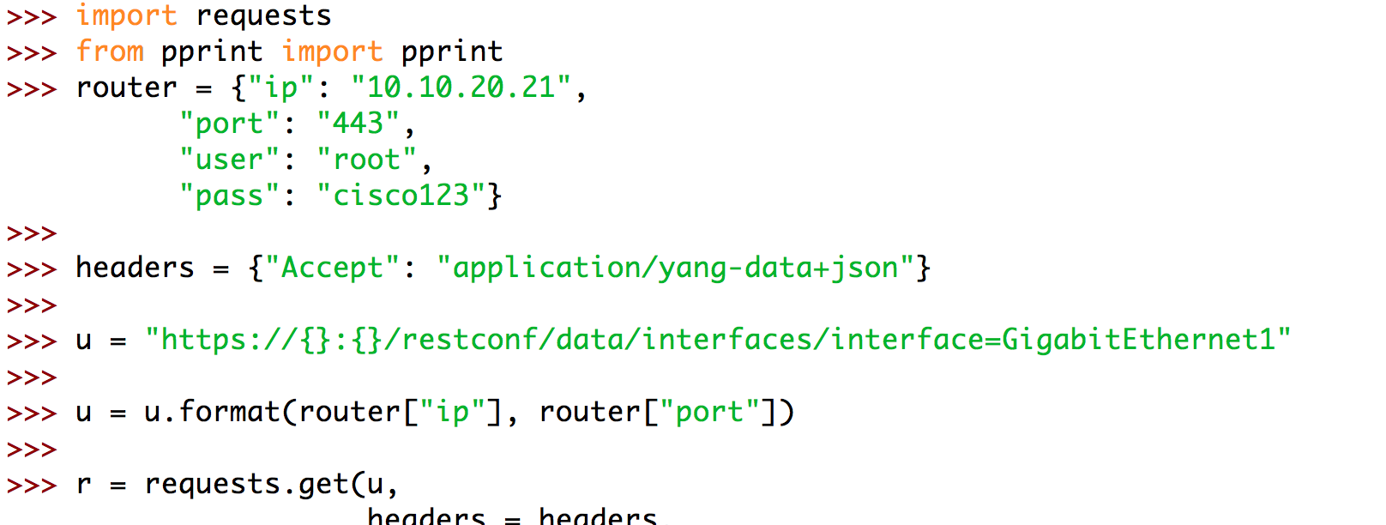
Make HTTP Calls with Ease using requests
Full HTTP Client
Simplifies authentication, headers, and response tracking
Great for REST API calls, or any HTTP request
https://github.com/psf/requests

Slide 76
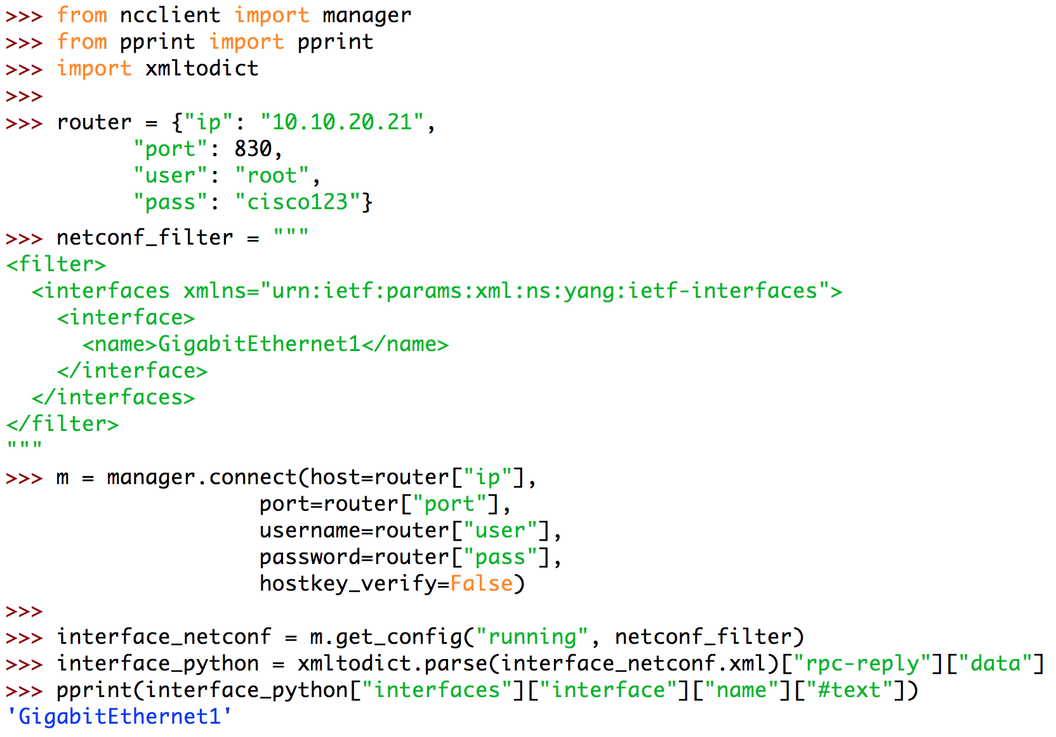
YANG Model Data with NETCONF and ncclient
Full NETCONF Manager (ie client) implementation in Python
Handles all details including authentication, RPC, and operations
Deals in raw XML
https://github.com/ncclient/ncclient

Slide 77
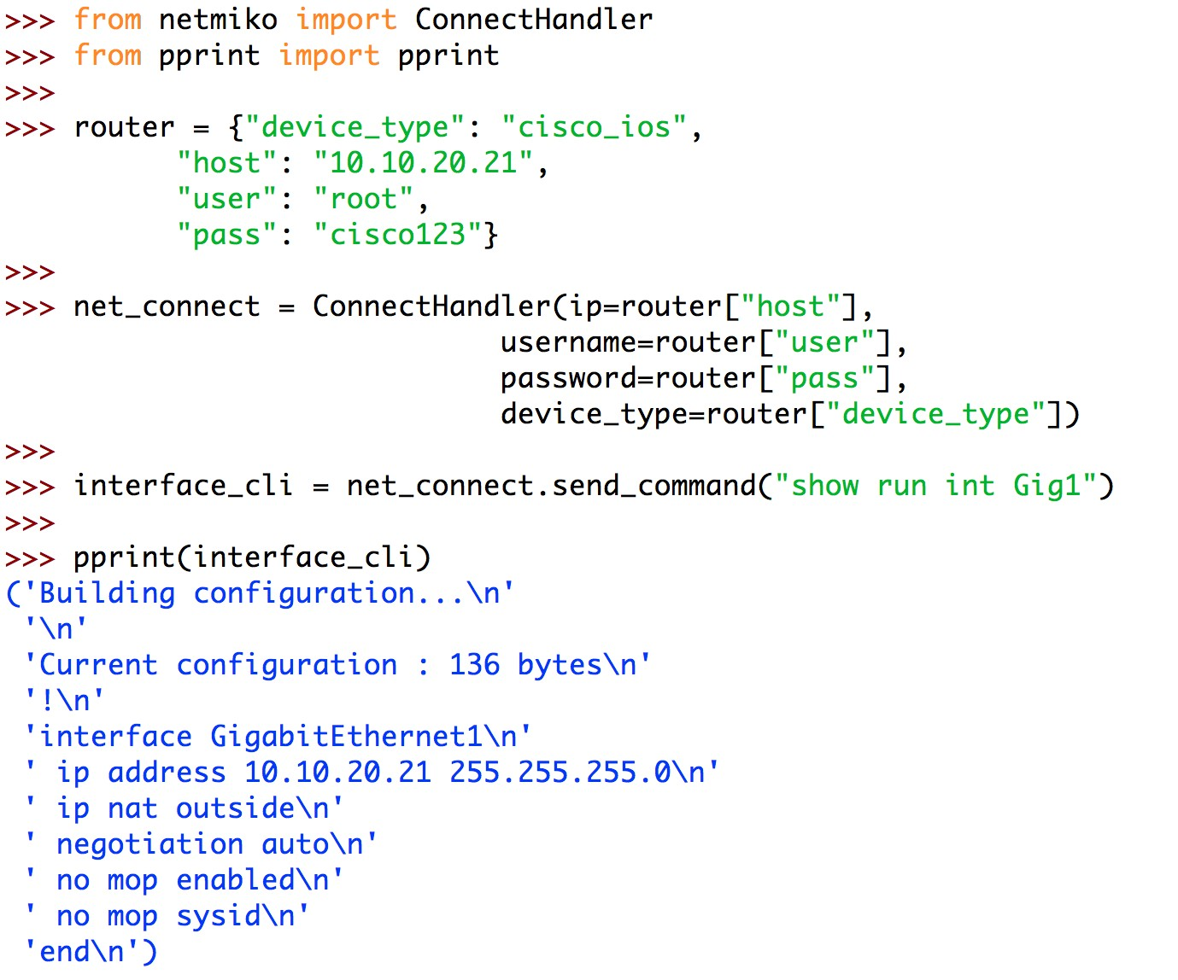
For When CLI is the Only Option – netmiko
If no other API is available…
Builds on paramiko library for SSH connectivity
Support for a range of vendors network devices and operating systems
Send and receive clear text
Post processing of data will be key
https://github.com/ktbyers/netmiko

Slide 78
Demo Time!
2.net_programming/demo/netmiko_demo.py
© 2017 Cisco and/or its affiliates. All rights reserved. Cisco Confidential

Slide 79
Summary
Data Formats
Why?
What?
How?
Python
Why?
What?
How?

Slide 80
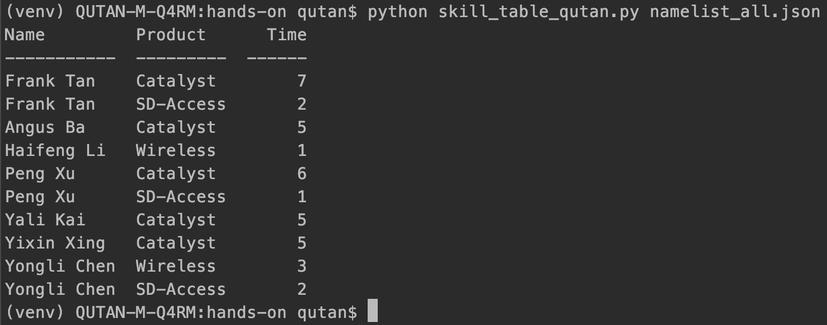
Hands-on
Print all participants’ skills as a table
Use tabulate package
Find data at 2.net_programming/hands-on/namelist_all.json

Slide 81
Continue to study..
Learn network programmability basics (DevNet Video Courses)
https://developer.cisco.com/video/net-prog-basics/
Python Tutorial
https://www.learnpython.org/

